Slide 1

BANKING ANALYTICS PROJECT
BANK DATA ANALYSTICS
AND
DEBIT AND CREDIT BANKING DATA
GROUP MEMBERS
Karthik M S
Ganesh Ram N
Samreen Saba
Alekhya
Mamta Sharma
Ankum Pruthvi Raj Kumar

Slide 2


I will be presenting two banking analytics dashboards.
First, Bank Credit and Debit Card Analysis Dashboard: This dashboard focuses on credit and debit transactions, monthly trends, bank-wise and branch-wise performance, transaction methods, and high-risk transactions.
Second, Bank Loan Analytics Dashboard: This dashboard focuses on loan amounts, interest, loan status, customer age groups, credit grades, and default rates.
Both dashboards help identify important trends, understand potential risks, and support better data-driven banking decisions.

Slide 3
Data analysis workflow
1
2
3
4
Prepare data
Build dashboard
Add slicers
Validate
Clean and format the 100,000 transaction rows (dates, flags, categories)
Analyzed banking data using Excel, SQL, Power BI, and Tableau to track KPIs, trends, and risks.
Filters: Risk Flag, Bank Name, Branch, Transaction Method, Date, and Transaction Type.
Compare SQL KPI queries (MySQL) with the dashboard values
Data Cleaning: Used Excel to clean the data, handle missing values, and ensure data quality.
Data Analysis: Used SQL to analyze transactions, calculate KPIs, and identify trends and risks.
Visualization: Created interactive dashboards in Excel, Power BI and Tableau to present insights and compare bank and branch performance.

Slide 4
KPI overview
₹12.76 Cr
₹12.73 Cr
100K
1.0025
Total Credit Amount
Total Debit Amount
Total Transactions
Credit to Debit Ratio
₹318.12K
20K
0.00019
Net Transaction Amount
High Risk Transactions
Account Activity Ratio
The KPIs give a quick view of the overall position before the detailed analysis.

Slide 5
Dashboard filters
High Risk Flag
Bank Name
Branch
Axis, HDFC, ICICI, Kotak Mahindra, Punjab National, State Bank of India
City Center, Downtown, East, Main, North, Suburban
High Risk or Normal
Transaction Method
Transaction Date
Transaction Type
Bank Transfer, Credit Card, Debit Card
Date range slider (1/1/2024 to 12/1/2024)
Credit or Debit
Used filters for date, risk flag, transaction method, bank, branch, and transaction
Type to analyze specific transactions and compare performance.

Slide 6
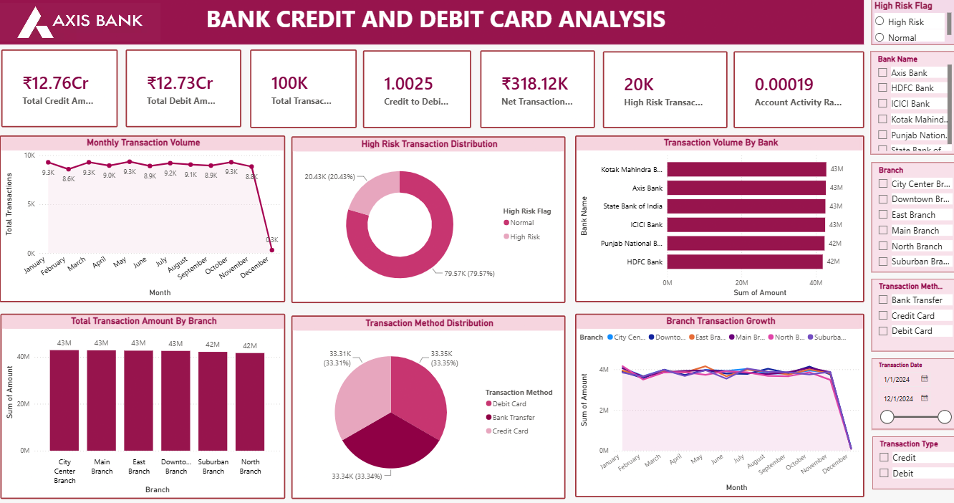
Monthly transaction trend
Stable: about 8.6K to 9.3K transactions a month, January to November
December: drops to about 0.3K
Next step: check whether December data is complete before drawing business conclusions
The sharp December drop is the most important anomaly in the trend.

Slide 7
Bank-wise and branch-wise volume
Volumes are almost identical (42M to 43M), so growth and risk matter more than size.

Slide 8
Dashboard

Slide 9
Data analysis workflow
1
2
3
4
Cleaned data
KPI calculations
Pivot analysis
Dashboard
Prepare the 65,535 loan records and fix column, date issues etc
Analyzed funded loans, interest earned, defaults, and delinquency rates to assess credit risk.
Pivot Tables and Pivot Charts by city, product, age, grade and status
Slicers on the dashboard; KPIs compared with SQL queries
Why this order mattered
Cleaned data in Excel, analyzed trends using SQL, and created interactive dashboards in Power BI and Tableau.

Slide 10
KPI overview
Total Loan Amount
Total Loans
Total Interest
Default Loan Count
₹ 732,697,200.00
65535.00
₹ 155,288,805.82
₹ 814,902,500.45
Total Collection
Default Loan Rate
Delinquent Loan Rate
No Verified Loans Count
₹ 814,902,500.45
1.56%
10.84%
16921
Insight
1,020 defaulted loans keep the default rate at 1.56%. The 10.84% delinquency is the early-warning pool for proactive monitoring.

Slide 11
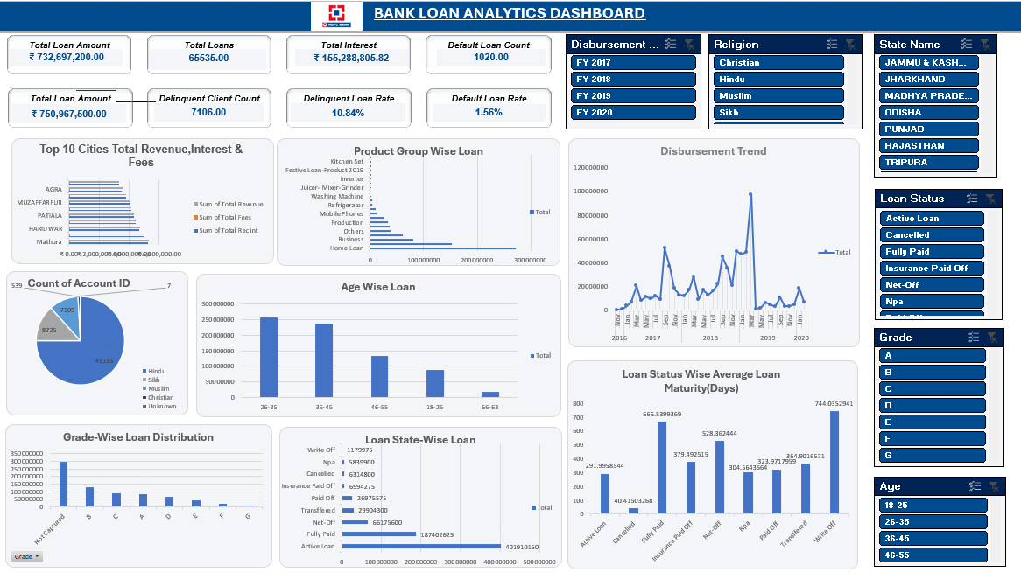
Age-Wise Loan and Loan Status-Wise Analysis
Age-Wise Loan
Customers aged 26–35 and 36–45 account for the highest loan amounts.
The 56–63 age group has the lowest loan amount.
Loan Status-Wise Analysis
Active Loans have the highest amount, followed by Fully Paid loans.
Write-Off, NPA, and Cancelled loans show much lower amounts.
Insight
Active loans dominate the portfolio, so monitoring repayment performance and delinquency is important to manage credit risk.

Slide 12
Disbursement Trend and Grade-Wise Loan Distribution
Loan disbursements fluctuate significantly over time.
A major peak appears in early 2019, followed by a sharp decline.
Not Categorized represents the largest loan amount.
Grade B, C, and A follow, while Grades F and G have the lowest amounts.
Insights
Loan disbursements show sharp fluctuations, while the large uncategorized loan segment highlights the need to investigate unusual trends and improve credit-grade classification.

Slide 13
Dashboard filters
Disbursement Year
Religion
State Name
FY 2017, FY 2018, FY 2019, FY 2020
Christian, Hindu, Muslim, Sikh, Unknown
Assam, Bihar, Haryana, Odisha, Punjab, Rajasthan and others.
Loan Status
Grade
Age Group
Active Loan, Cancelled, Fully Paid, NPA, Write Off, and others
A, B, C, D, E, F, G, Not Captured
18–25, 26–35, 36–45, 46–55, 56–63
Insights
Used filters for year, religion, state, loan status, grade, and age group to compare loan trends, customer segments, and credit risk.

Slide 14
Dashboard

Slide 15
Conclusion
Analyzed loan performance across 65,535 loans and identified a 1.56% default rate.
Identified 10.84% delinquency, highlighting the need for better loan monitoring.
Credit and debit amounts are nearly balanced at ₹12.76 Cr and ₹12.73 Cr.
Around 20.43% of transactions are high-risk and require closer monitoring.
December shows a sharp drop in transaction volume that needs investigation.
Interactive dashboards help compare performance and support better banking decisions.

